Slide 1
LazyDMz
Tanveer Bariana
Jerry Thao
Xavier Lamphere

Slide 2
The Problem
There are no software suites online that implements the tools that our customer needs in the way they want.

Slide 3
Solution
We create an application suite that combines the tools that they need in the way they want.

Slide 4
Goal of Project
Create an suite of tools that will help GMs manage games
Character sheet sharing
Map generator
Encounter generator

Slide 5
Requirement Specification
Formal meetings early on
Desired functionality
Became more casual as semester progressed
Progress

Slide 6
Actual Input
Customers liked ideas for character sheet
Near non-existant
Majority of input was for the map and encounter generator sections
Size
Number of maps/ enemies
Possible save and load functions

Slide 7
Methodology
XP
Iterative process
Constant contact with the clients
Minimal documentation
Embraced change
K.I.S.S

Slide 8
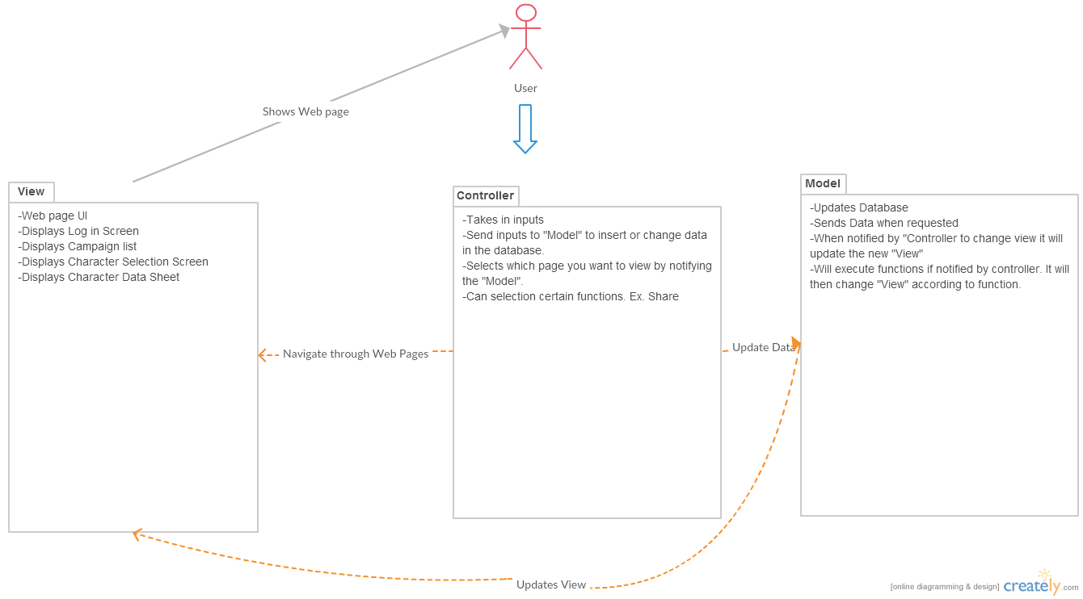
MVC Diagram

Slide 9
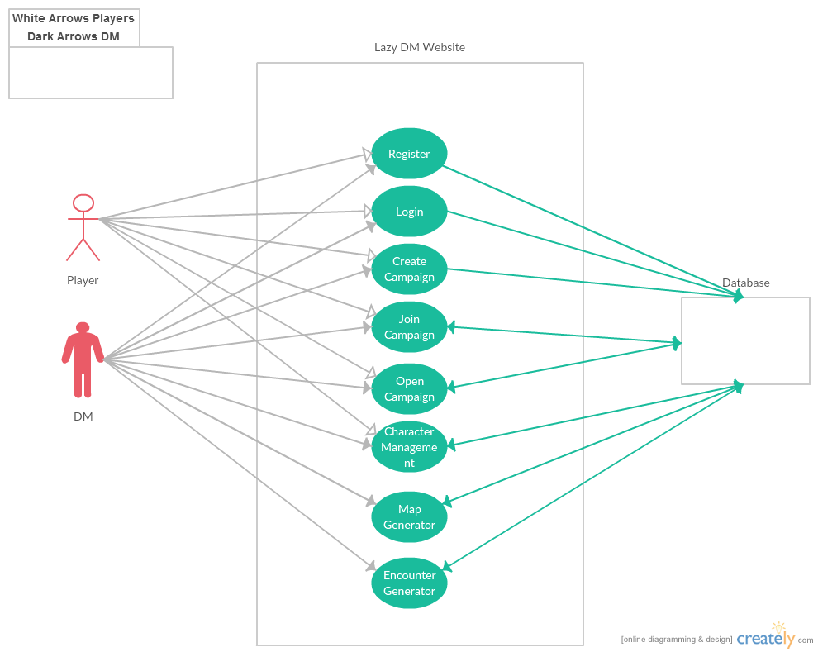
Use Case Diagram

Slide 10
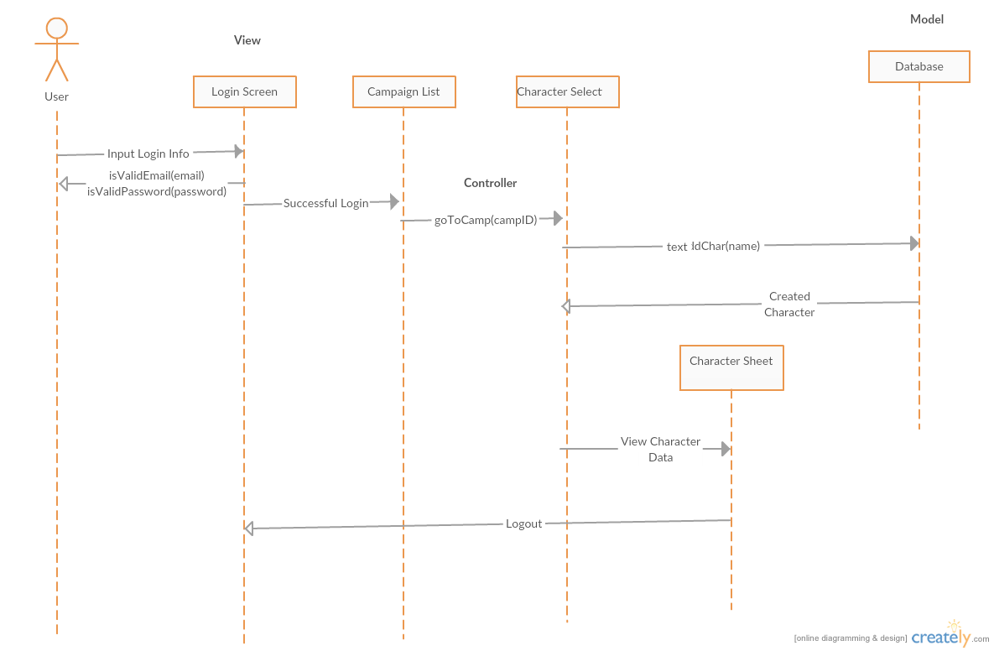
Sequence Diagram

Slide 11
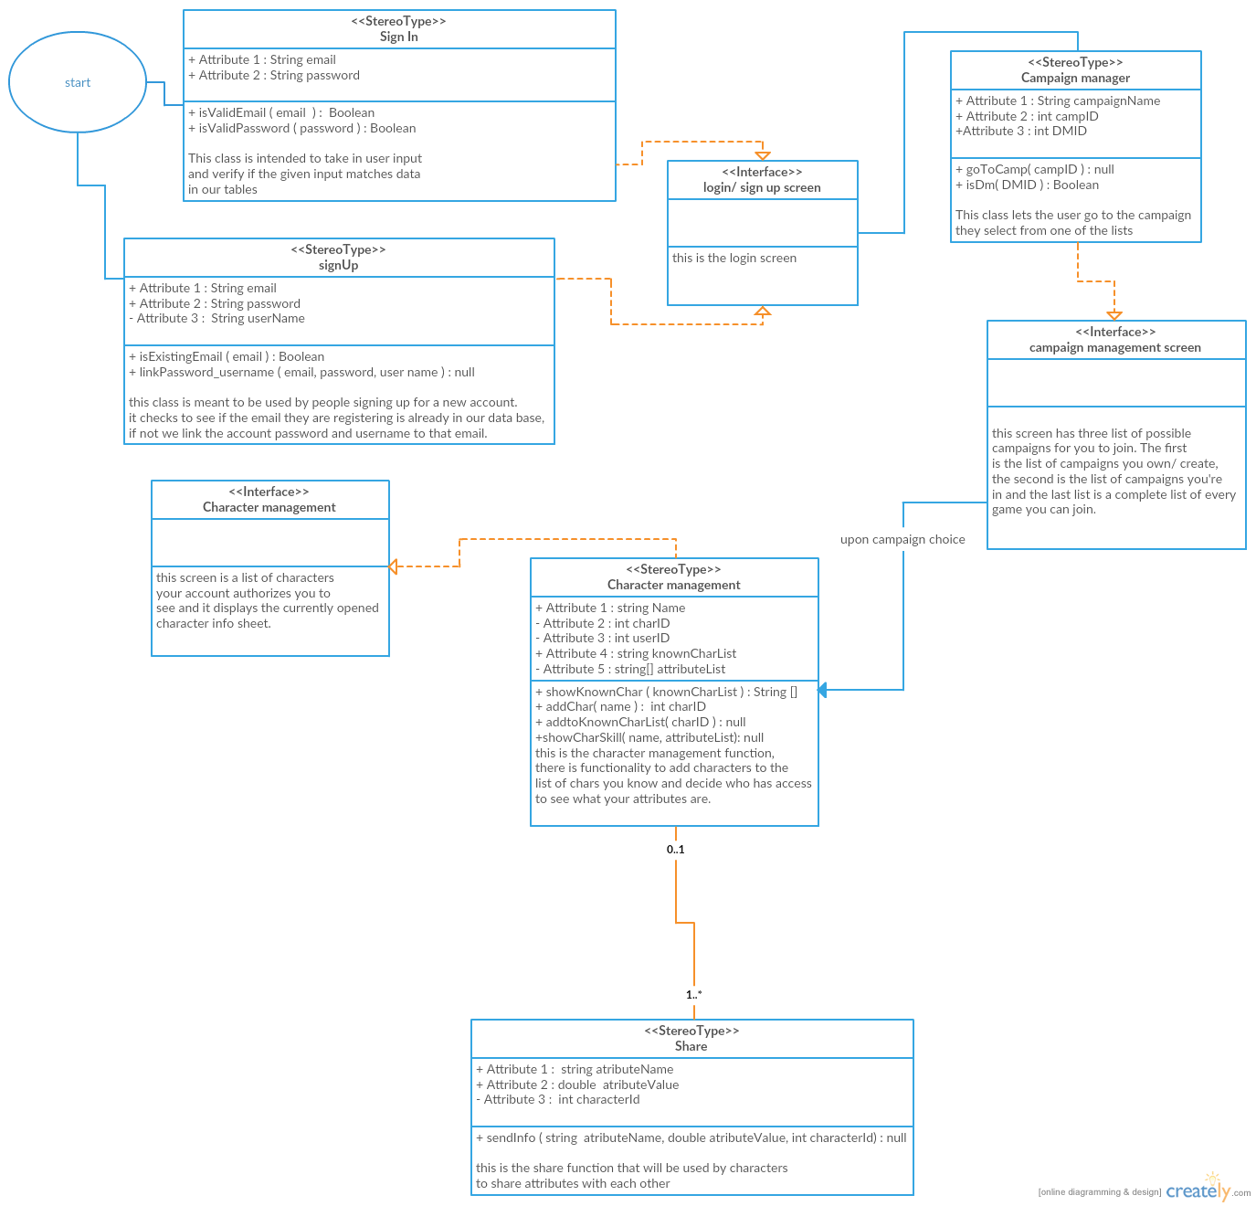
Class Diagram

Slide 12
Functional Requirements
Identifier | Description
REQ_1 | The system shall be able to register new users to the website.
REQ_2 | The system shall, if the user registers for the website, ask for a username, email, and password.
REQ_3 | The system shall be able to log into the website using a created account.
REQ_4 | The system shall always offer an option to log out from any screen.
REQ_5 | The system shall, if the user uses log out, take them to login screen.
REQ_6 | The system shall display a list of campaigns after the user logs in.
REQ_7 | The system shall, on the campaign list page, allow the user to create a campaign.
REQ_8 | The system shall, if the user creates a campaign, prompt the user for a campaign name and then take them to character screen.

Slide 13
Functional Requirements (con.)
REQ_9 | The system shall, on the campaign list page, allow the use to open a campaign that they have already joined
REQ_10 | The system shall, on the campaign list page, allow the user to join an existing campaign.
REQ_11 | The system shall, if the user joins a campaign, take them to the character management screen.
REQ_12 | The system shall, if the user opens a campaign, if the user is a player, take them to the character management screen.
REQ_13 | The system shall offer a back option at the character management screen.
REQ_14 | The system shall, if the user uses the back button, if the user is a player, take them to the campaign list page.
REQ_15 | The system shall, if the user uses the back button, if the user is a DM, takes them to the character screen.
REQ_16 | The system shall, at the character management screen, allow the user to create a character, share character information, and see character information shared to their characters.

Slide 14
Functional Requirements (con.)
REQ_17 | The system shall, if the user opens a campaign, if the user is a DM, take them to the character screen.
REQ_18 | The system shall allow the DM to give their DM permissions to another user while removing their own.
REQ_19 | The system shall direct a user to the login screen if they are not logged in with a valid account.

Slide 15
Non-functional Requirements
REQ_20 | Ease of use: The user shall be able to use our tool with 15 minutes of training.
REQ_21 | Security: Forms will not submit unless valid info input
REQ_23 | Security: The website will be protected from SQL injection. Using client side validation.
REQ_24 | Security: All passwords will be hashed.

Slide 16
Demo

Slide 17
Lesson Learned
PHP, Html5, Javascript, Jquery, Bootstrap, SQL, mySQL, backend internet service provision
Talk about diagrams
Documentations assistance with planning
Working in team

Slide 18
Moving Forward
V 1.0 make character sheet Pathfinder specific
Map and encounter generator functionality included
V 2.0 add functionality enabling character sheet to be created from a list of available rpgs
V 3.0 format your owns character sheet.

